Slide 1
Backup Inertial
Navigation System
(B.I.N.S.) Preliminary Design Review
Colorado State University
Team Members:
Graham Avers
Elliot Matlack
Alex Eriksson
Date:
06/02/2022
Notes:
‹#›

Slide 2
Mission Overview
Main Objective:
To determine the final position of a payload accurately without the use of GPS tracking or remote assistance.
Problems Addressed:
Achieving an accurate estimate of a payload final position
Compounding errors in dead reckoning (drift)
Reduction of cost
High accuracy sensors are expensive
Notes:
‹#›
Hope to prove this can be done with reasonable accuracy within our budget and that the issues with previous implementations of IMU’s can be solved with the integration of topographical maps and images

Slide 3
Mission Overview
Three Different Methods to determine position:
Inertial Measurement Unit (IMU):
- 3 sensors: Accelerometer, Gyroscope, Magnetometer
- Can calculate Orientation, Velocity, and Position from these sensors
- Using rectangular integration
Terrain Recognition:
- Take pictures of ground when descending
- Use pictures to get a rough estimate of position
Topographic Comparison:
- Use an altimeter to get altitude position at landing
- Use altitude with topographical map to determine possible final positions
Notes:
Integration: By constantly taking acceleration values in three axes and orienting them correctly using the gyroscope and magnetometer, the velocity in relation to a fixed axes system can be found. Integrating again results in change in position in relation to these fixed axes. A flight path can be modeled based in this data.
Terrain Recognition: By looking at the pictures taken by the device upon decent, we may be able to manually correct and periodically correct our estimated position in order to narrow down possible landing zones if the IMU data is off by a significant margin.
Topography Comparison: For the entirety of the flight, the module will be taking altitude measurements. The altitude measurements taken at the beginning and end of the flight will be compared to a topographical map of the estimated landing area. The data point with the closest calculated height value when compared to the altimeter reading will be specified as the exact landing point.

Slide 4
Sensors
Accelerometer: Reads force, has known mass attached to a “spring”, calculates acceleration using F=ma
Gyroscope: Calculates the angular velocity by determining the force exerted upon a mass due to centripetal acceleration about the center of rotation.
Magnetometer: Uses a semiconducting material to pass current through, and assesses disturbances in current which relates to the Hall voltage, which is proportional to the magnetic field. Detects direction of magnetic field lines via current inducted
Barometer: A diaphragm is expanded or contracted based on the pressure difference between the inside and outside of the sensor

Slide 5
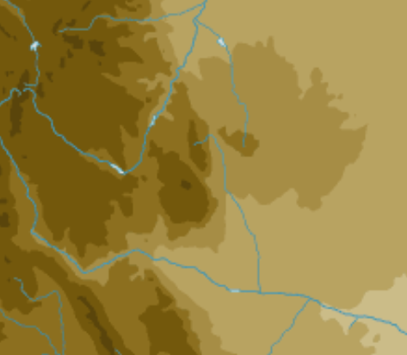
Code
IMU says we are at red dot (coordinates)
Pictures show we landed on the West side of a river
Altimeter shows that we are at a height of the darkest brown color
Using that data we can infer we are here
Calculated error in IMU

Slide 6
Math for IMU
Recorded data:
Accelerometer data Linear Accelerations (m/s^2)
Gyroscope data Angular Velocities (rad/s)
Magnetometer data Heading relative to earth’s magnetic fields (units vary)
Procedure of Matlab Script:
Import data
Calculate linear accelerations
Apply Calibrations*
Factor out gravitational interference*
Calculate orientations (pitch,roll,yaw)*
Calculate velocities using summation
Calculate position using summation
*depending on sensor these may not need to be done
Notes:
The most important set of data to get an accurate position, will be the linear acceleration readings.
However, the craft will be spinning, and the orientation of the axis’ in relation to the ground will constantly be changing.
To counteract this, a gyroscope will be used to record angular velocities
This data can then be used to calculate the change in degree of the accelerometer from the original orientation
Throughout the flight, these changes in theta will be continuously accounted for, and the linear acceleration values will be calculated by the summing the components in the original axes directions
The acceleration values can then be converted to velocity, which will then be compared to our barometric data, and then from this corrected velocity data, position can be calculated

Slide 7
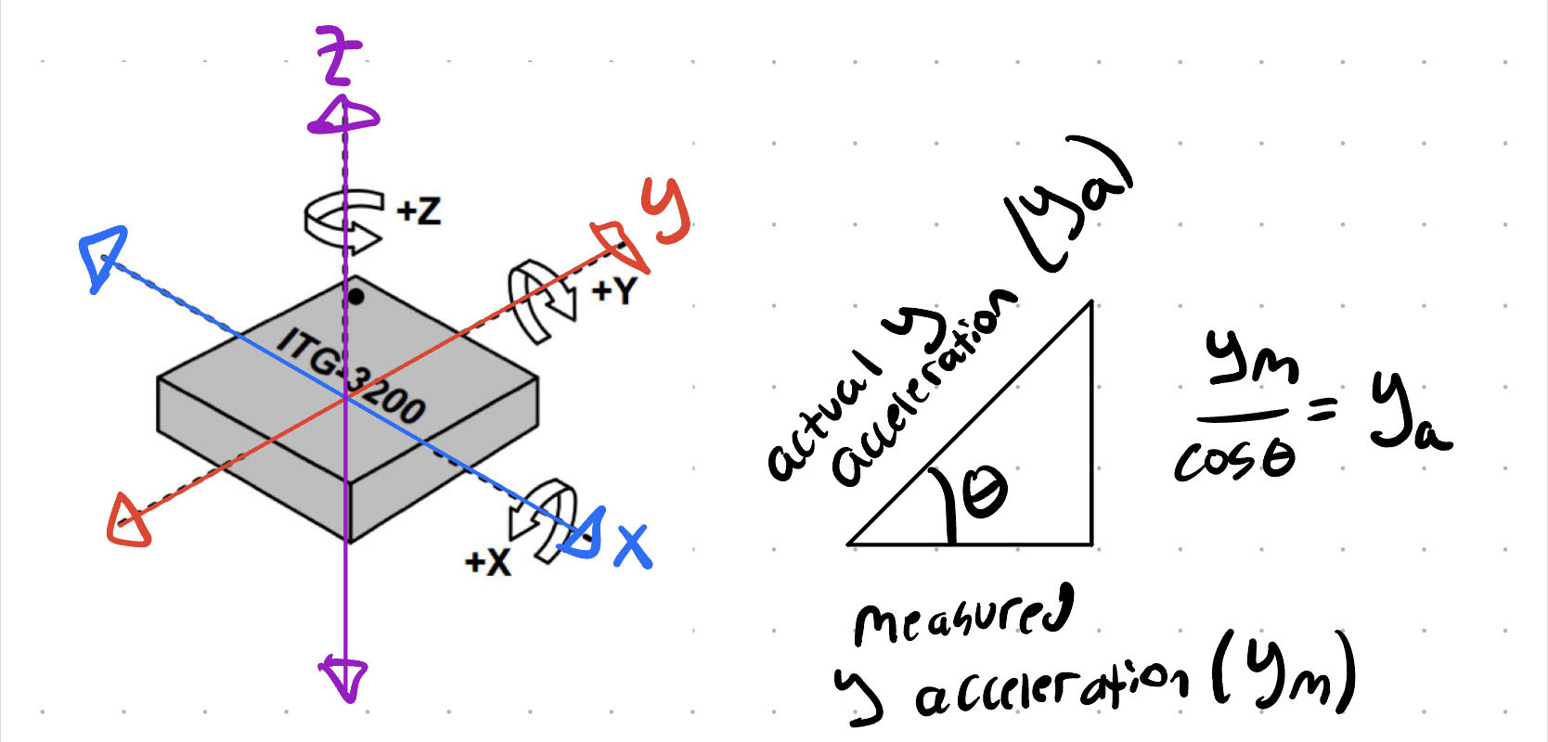
Code IMU
Remove gravity component (土9.81sin(Θ))
Acquire calibration factor for IMU (leave device on a level table and average recorded values)
Calculate full acceleration components (a_{measured}/cosΘ = a_{actual})

Slide 8
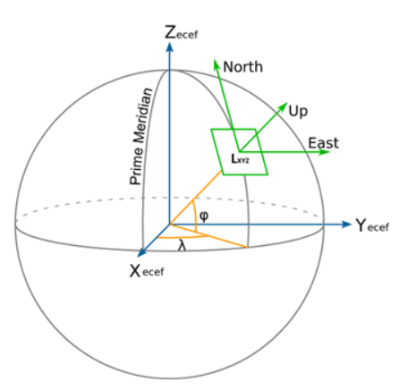
Math
2 different ways of calculating final position:
Constantly change axes
Uses vectors
Requires use of linear algebra
Convert every reading to a predetermined axis
Calculate the actual acceleration values on our original predetermined axis
Simpler math
Right hand coordinate system ENU
East = +X, North = +Y, Up = +Z
Notes:
Alex

Slide 9
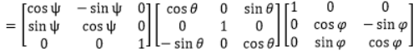
Code: Acceleration Calculations
Using a rotation matrix (R_{LS}) to convert acceleration detected by sensor to acceleration in global coordinate system
a_{s} = original acceleration vector (given directly by sensor)
ψ = yaw , θ = pitch, φ = roll (given directly by sensor)
R_{LS}=
Z matrix Y matrix X matrix
a_{L}= acceleration vector in global coordinates (x,y,z)
a_{L}= a_{s} * R_{LS}
Notes:
Alex
By calculating the rotation matrix (R_{LS}) and multiplying it by the sensors acceleration values (x_{s}), we get the acceleration of the sensor in reference to a fixed global coordinate system which we can then integrate twice to find position in relation to a starting point on the earth’s surface.

Slide 10
Code: Velocity and Position Calculations
Integrate Acceleration data points using rectangle method:
Velocity(t) = Velocity(t-dt) + Acceleration(t) * dt
Position(t) = Position(t-dt) + Velocity(t) * dt
Complete these calculations for each axis (x,y,z), with the end result being our exact position at each point in time for the entire flight.
Notes:
Alex: After using our rotation matrix to find the acceleration in the global coordinate system, we can use numerical integration methods to find velocity and then position. Using the position data for every measurement time for our entire flight we will be able to create a 3D model of our flight path to overlay onto google maps

Slide 11
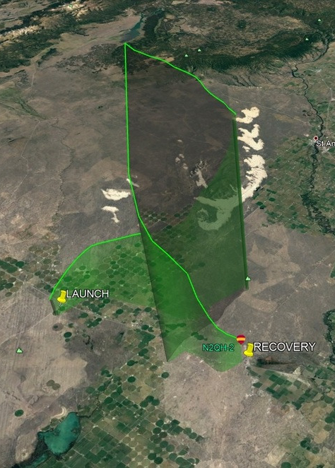
Code
2 different sets of code
1st set: On-board Arduino Code
Responsible for recording IMU, and Altimeter data during flight
Responsible for taking pictures during flight
2nd set: Post-Recovery Calculations
Calculates final position from raw data recorded
Coordinates
Creates 3d path alongside recorded GPS values
Compares recorded altimeter final position to possible X and Y coordinate positions

Slide 12
Challenges
Frequency of measurement recordings
10+ different measurements being taken at 100 Hz
A single arduino may struggle with this much data, additional processing units may be needed
Accuracy
Accumulated error (drift)
With this limited budget, it is hard to get extremely accurate sensors
Coding
Creating an estimate of position based off the three location inputs
Notes:
Accuracy: If the error in sensor measurements is consistently off by a certain amount in one direction the error at the end of the flight path calculation will be off by much more than just the error of one sensor measurement
Solutions: The MTi-3 sensor we chose from Xsens has built in sensor fusion which corrects each sensor measurement based on the values from the other sensors (Accelerometer, gyroscope, magnetometer) and reduced error by a considerable amount

Slide 13
Solutions
Accumulated error (drift):
Reduce error wherever possible:
Calculate gravitational acceleration based off altimeter (not constant 9.81)
Kalman Filtering
Majority of modern IMU’s have this built in
More methods of determining position = More accurate estimation
Images
IMU calculated position
topographical map, analyzed with altimeter reading

Slide 14
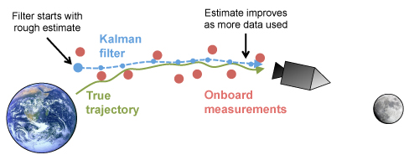
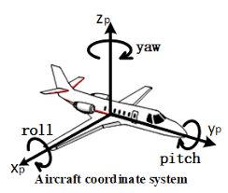
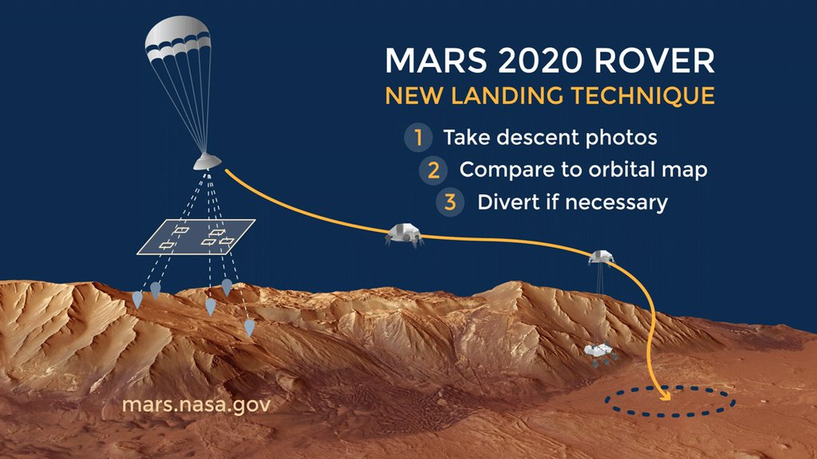
Previous Applications
Apollo Missions
Airplanes
Perseverance Rover (2020)
Notes:
Apollo: 1961, developed at MIT. Used Kalman filters for INS
Airplanes: Attitude and heading measurements are made using a combination of IMU data and GPS
Perseverance Rover: The rover’s lander made use of image recognition software which allowed the lander to orient itself with the terrain below and correct its course if it was

Slide 15
Subsystems
Sensors and Data Collection
9 axis IMU sensor (3-axis accelerometer, gyroscope, magnetometer)
2 barometers (high sens and low sens)
2 Data Loggers
2 Batteries
Thermal Regulation
Temperature sensor
Relay
Heating element
Battery
Structural
Frame components
Insulation
Notes:
‹#›
Elliot

Slide 16
Subsystem Requirements
Sensors
Calibrated gyroscope, accelerometer, magnetometer, altimeter, temperature sensor
Data Logging
Sufficient storage space on micro SD card
Arduino communication
Power
Supply 3W for heater and <0.5W for the other electrical systems
Thermal
Must maintain internal temperature of above -40 ⁰C
Structural
Has to withstand up to 15 g’s
Interior of the structure must be easily accessible
Notes:
‹#›
Elliot
kalman filtering - takes into account inaccuracies and makes predictions based on past data. smooths noise

Slide 17
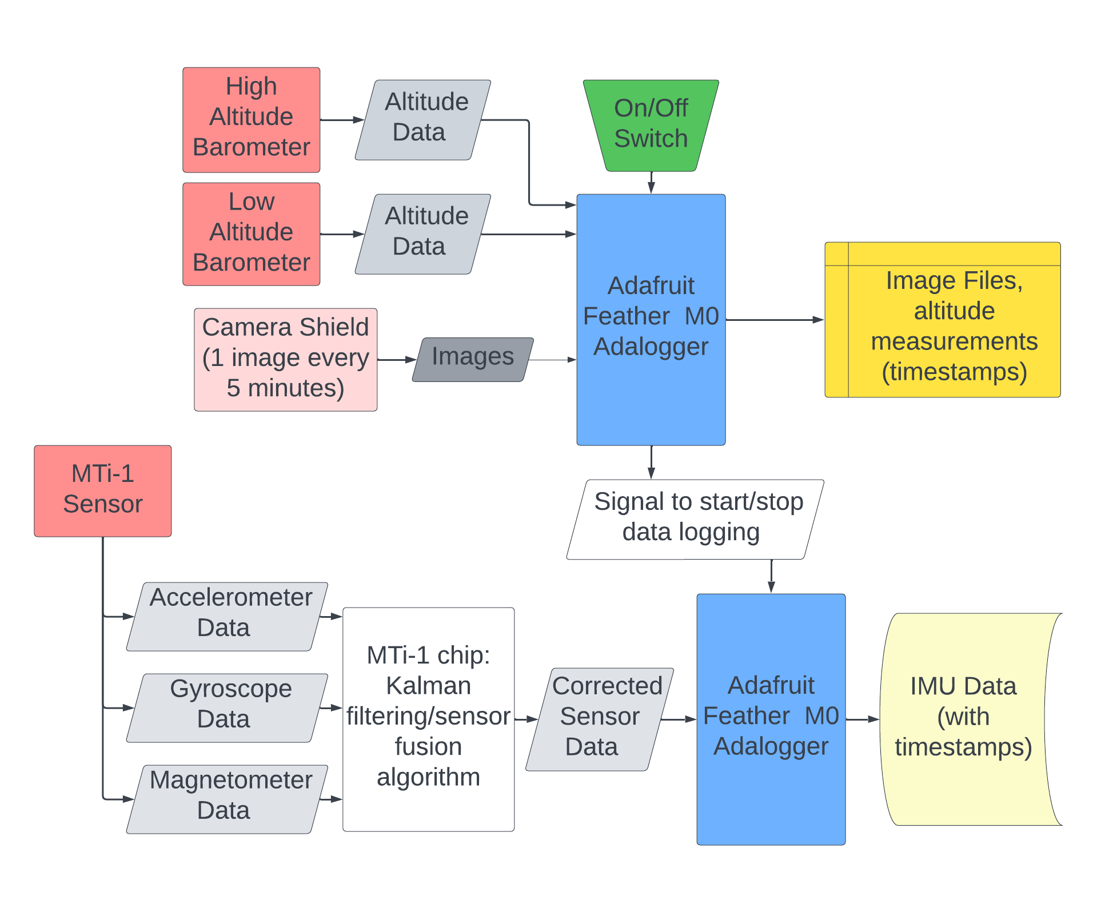
Block Diagram
Notes:
Elliot
Red: Sensors
Blue: Microcontrollers
Grey: Data
Yellow: Data storage

Slide 18
Special Requirements
Problem:
The flight string must be slightly re-routed to allow the IMU to be as close to center of rotation as possible
Solution:
Add supports to offset the string tube by ¾” in the center of the structure
Notes:
Elliot

Slide 19
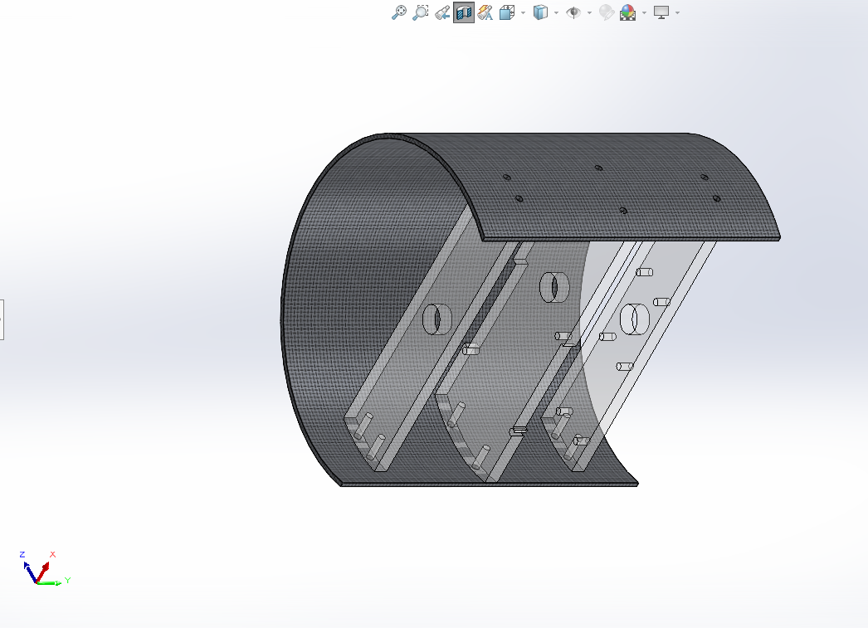
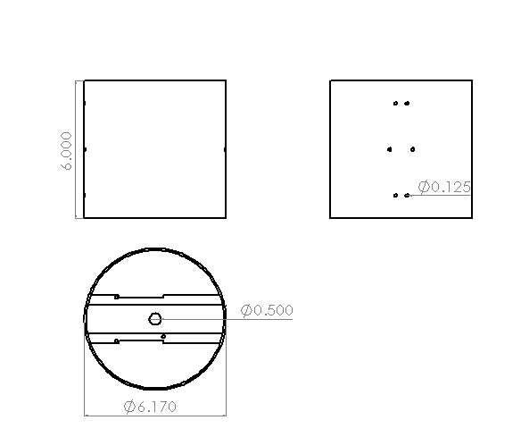
Design 1: Cylinder Shape
Notes:
Elliot
Carbon fiber cylinder with supports to offset the string tube by ¾”
mounting holes for the sensors boards and batteries on the supports

Slide 20
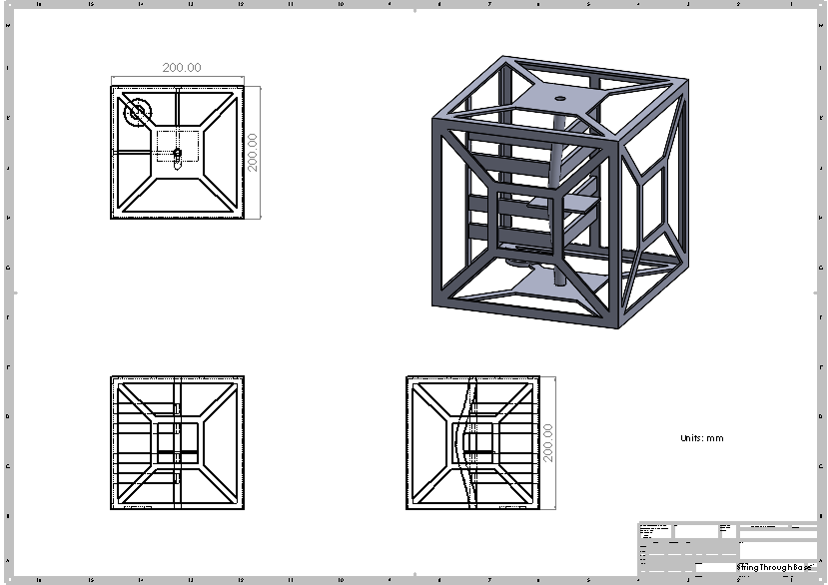
Design 2: Box Shape
Notes:
Elliot
Simple design made of individually created side panels
Polyethylene tubing inserted inside inner tube
Lateral support for tubing structure down center
Space Allocated for multiple sensor setups and Camera

Slide 21
Testing
Cold testing
Leave in cooler with dry ice for 2 hours
Vacuum testing
Use vacuum chamber in Powerhouse campus
Rigidity testing
Throw package down concrete stairs
Spin around on string and whip back and forth
Simulates G forces experienced at burst
Code Testing
Using iphone recorded data on matlab app to test code before using actual IMU
Iphone sensors are very inaccurate
Notes:
Elliot

Slide 22
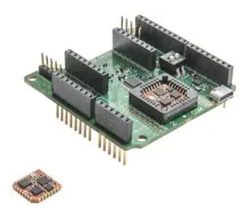
Commands and Sensors
Xsens MTI-3-0I-DK:
Very high accuracy sensor
Compatible with MT Manager (Xsens data manipulation suite provided for free)
Sensor fusion improves accuracy
2.8-3.6 V input
<100 mW @ 3V
$413.30
Notes:
Alex
Xsens sensor fusion algorithm uses the data acquired from all three types of sensors to more accurately provide orientation measurements based on the direction of gravity by the accelerometer and the measurement of the direction of earth’s magnetic north by the magnetometer.

Slide 23
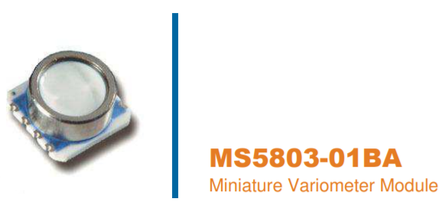
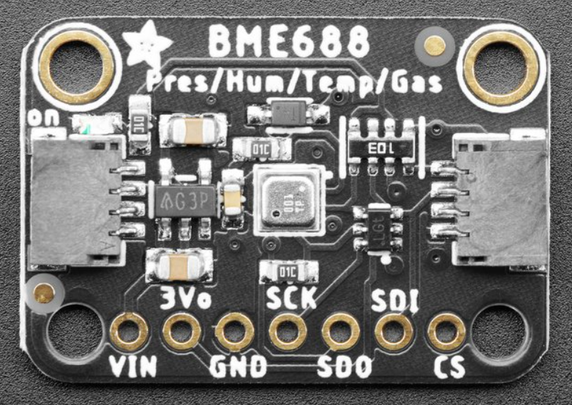
Commands and Sensors
Barometers
TE Connectivity MS5803-01BA:
Altitudes up to 30000 Meters
Accuracy of ± 5 meters
Peak 1.4 mA @ 1.8V to 3.6V
Bosch Sensortec BME688:
Altitudes up to 9000 Meters
Accuracy of ± 0.66 Meters
Peak 0.8 mA @ 1.2V to 3.6V
Notes:
Alex
One high altitude barometer and one low altitude barometer with high accuracy

Slide 24
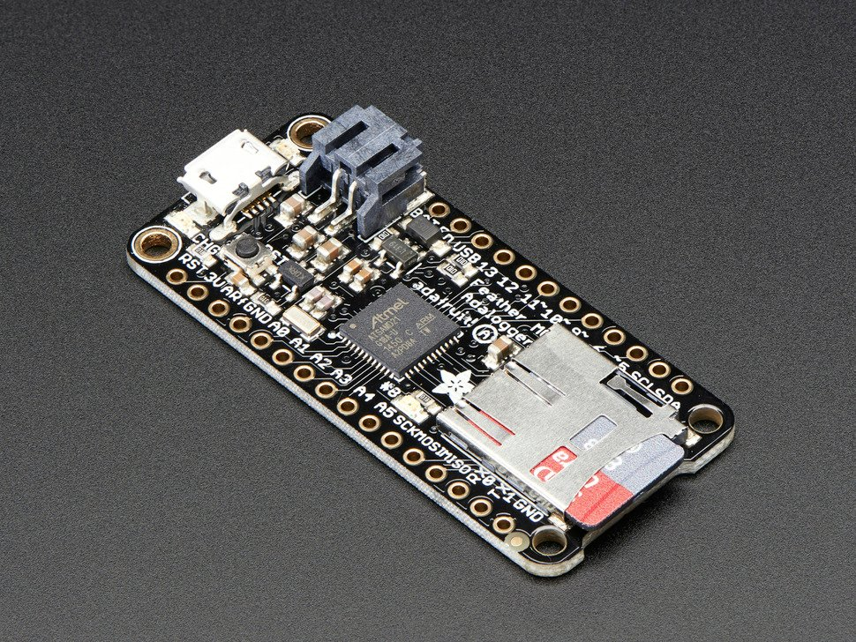
Commands and Sensors
Adafruit Feather M0 Adalogger
Operating Voltage 5V
32 kb Flash Memory
Clock Speed 48MHz
Operates from -40C to 85C
Built-in SD card slot
Use 2 in total. One for Xsens
MTi-3 and one for all other data
collection and processing
Notes:
Alex

Slide 25
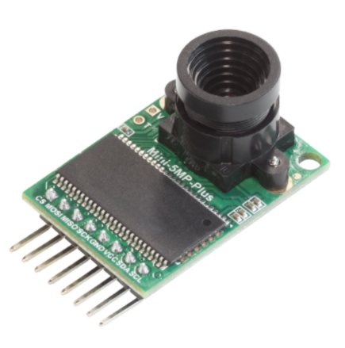
Commands and Sensors
ArduCAM Mini Camera Module Shield w/ 5 MP OV5642
5 megapixel camera
Interfaces with arduino
Notes:
Alex
This camera gives us high enough resolution to be able to recognize key terrain markers and estimate horizontal position. In tandem with the Altimeter and orientation given directly by MTi-3 Sensor module, an estimated position in space relative to terrain can be manually calculated based on the timestamped data from all three devices.

Slide 26
Parts List Contd.
Component | Distributor | Manufacturer | Weight | Price
MTi-3 IMU sensor module | Newark | Xsens | <25g | $413.30
Low Altitude Barometer & Temp Sensor | Adafruit | Bosch | 1.7g | $19.95
High Altitude Barometer & Temp Sensor | Digikey | TE Connectivity | <5g | $33.63
Battery x3 | Amazon | EEMB Battery | 3x30g =90g | $15.19 x 3 = 45.57
Data Logger / Microcontroller x2 | Adafruit | Adafruit | 5.3g x 2 = 10.6g | $19.95 x 2 = $39.90
ArduCam OV5642 | Amazon | ArduCam | 20g | $39.99
Insulation/frame | TBD | TBD | 483.31g | TBD
 |  |  | Total: 635.61g | Total: $591.28
Notes:
Elliot
If weight needs to be reduced, only use one support to offset the string tube

Slide 27
Management
Updated Organizational Chart
Budget
$1000
Schedule:
June 3rd Preliminary Design Review
June 6th Critical Design Review
June 13th Have all parts ordered
June 20th Begin testing individual components
June 27th Troubleshooting
July 5th Assemble final product and begin testing
July 11th Finish assembling and testing final product
July 18th Work on calculations based on imaging
July 30th Launch Date
August 12th Submit Final Report
Notes:
‹#›

Slide 28
Conclusion
Issues and concerns:
There are some concerns with how the sensor accuracy will be affected over a flight time of 2 hours. With the added accuracy of the still image camera and topographical map comparison, accuracy should be increased significantly over solely using an IMU
The objective of this project is to provide a relatively low cost solution for accurate position tracking without the use of GPS all while addressing:
Sensor accuracy (offset and gain error)
Sensor noise (random error)
Device Orientation
Data drift and compounding errors
Notes:
‹#›
Questions for NASA rep:
String routing around center of assembly
What types of batteries can we send up without worrying about them exploding
Partially filled prints and print density in near vacuum conditions
Can we get gps data from balloon assembly to compare with our data
Extra weight
are we able to get gps data

